Slide 1
Key Economic Narratives in an Uncertain Era
Ben Shiller
Finland
2025

Slide 2
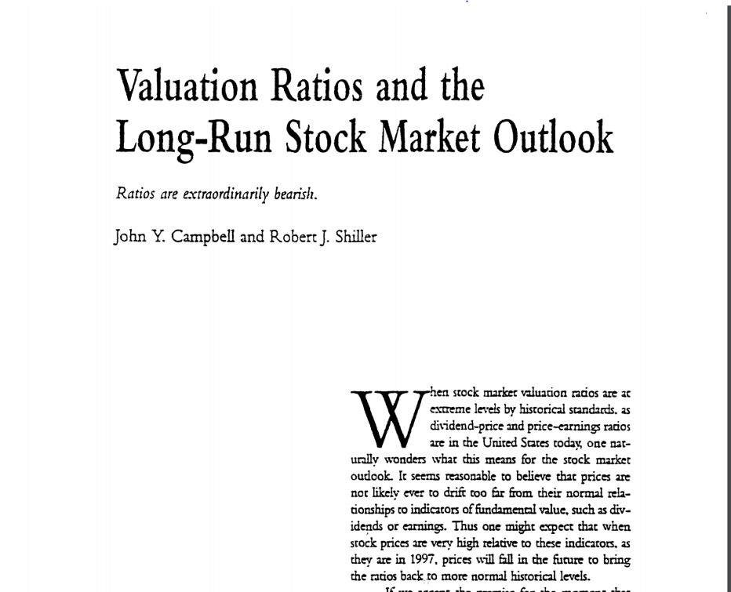
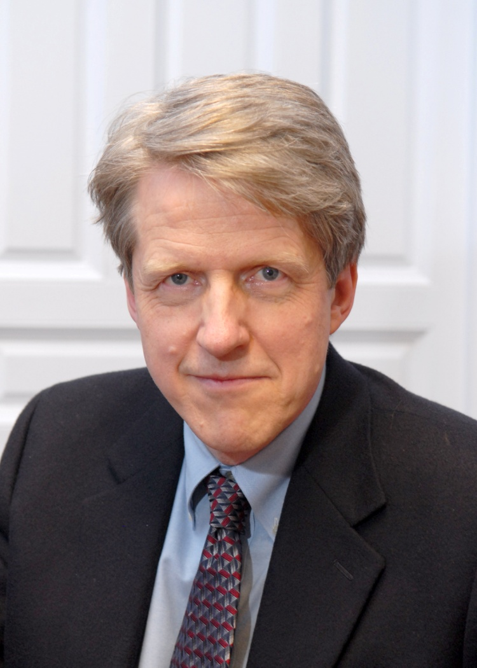

The CAPE Ratio: Cyclically Adjusted PE Ratio
Real Index Price
10-Y Average of Inflation Adjusted Index Earnings
CAPE =
Formally defined by Robert Shiller and John Y. Campbell during the late 1980s
Used to identify long-term under and over valuations of equity markets
Averaging earnings over 10 years allows for mean reversion of earnings and earnings over the business cycle

Slide 3

Why is the CAPE Ratio Valuable?
CAPE
Ratio:
10 Years
PE:
1 Year
To be successful, one has to be contrarian and
look at the world differently
Not many investors use 10-year metrics,
most are short-term focused

Slide 4
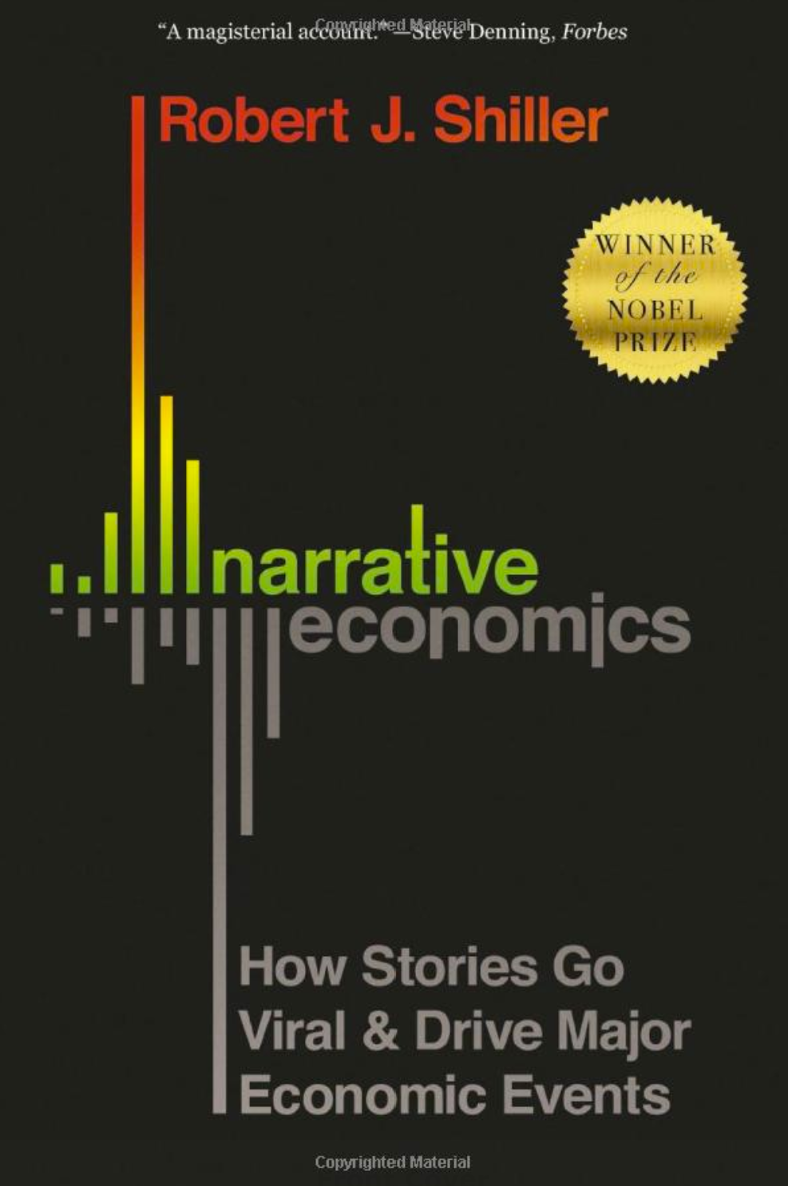
What is a Narrative?
Based on 2019 book Narrative Economics by Professor Shiller
Changing thinking is spread by contagion of narratives or stories
Most people never talk about economic theory, but make economic decisions in ignorance, motivated by simple narratives
Human interest stories spread deep feelings about economic decisions
There are perennial narratives that “mutate” and reappear in subsequent waves.
Source: Professor Shiller, Narrative Economics PUP 2019

Slide 5

Key Narratives: Gamification of Markets AI Narrative “Strongman”/Uncertainty American Dynamism

Slide 6
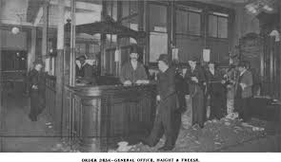
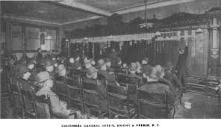
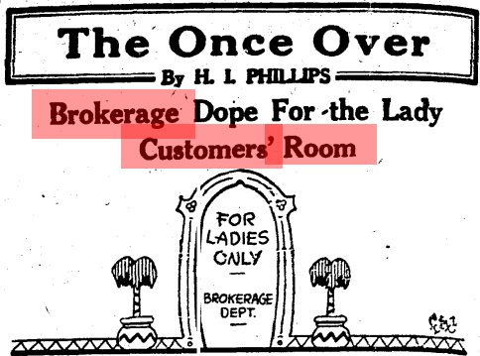
Gamification of Markets – Bucket Shops
1920’s – Bucket Shops/Customer Rooms made it easier to “bet” on markets
Source: Google.

Slide 7
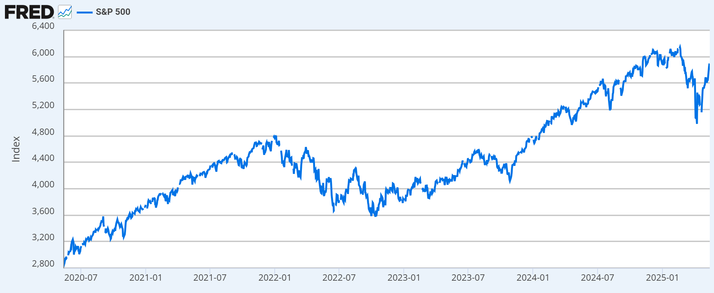






Gamification of Markets – The US Today
It is now much easier for retail investors to access exotic products.
In 2024 50% of US ETF launches were derivative based*
Became
popular
Meme
Mania
Single
Stock ETF
Zero-date
options
Bitcoin
ETF
Prediction
Markets
2020: 30 mln new US retail investors enter the market. 2021: Account for
25% of volume. 2023: Accounted for $1.5 bln dollars of weekly flow. (A high)*
Source: Google/Gemini and company websites. https://www.etftrends.com/record-etf-launches-derivatives-storm-scene/. S&P DJ and Nick Einhorn, Jill E. Fisch, Sergio A. Gramitto Ricci, Monique Le & Christina M. Sautter, The Retail Investor Report, Public.com (2023) Any data on past performance or results, modeling or back testing contained herein is no indication as to performance or results..

Slide 8
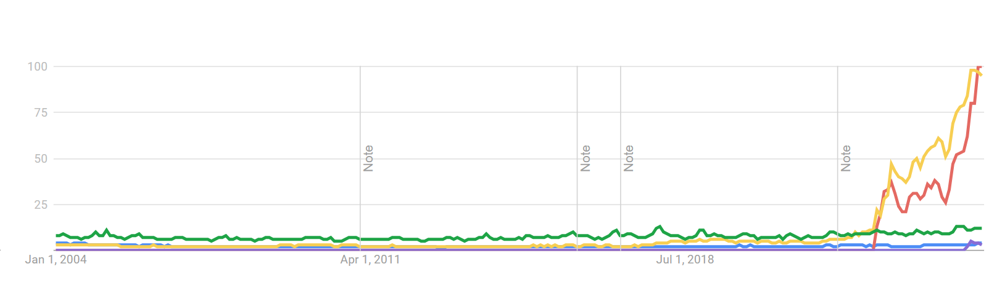
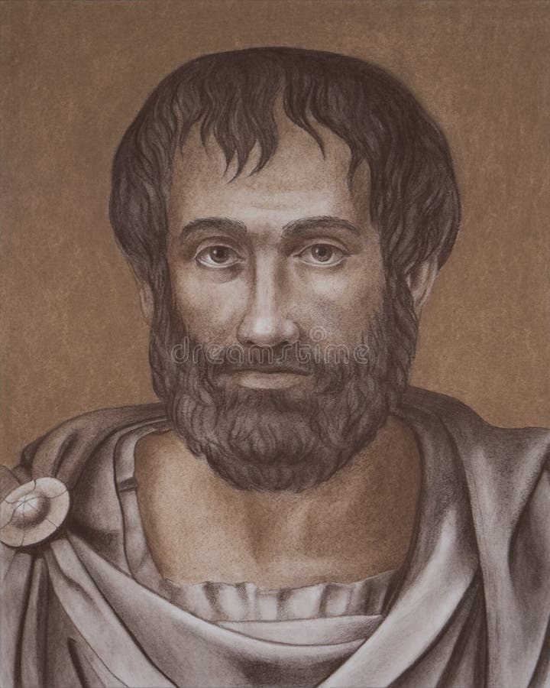
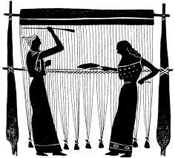
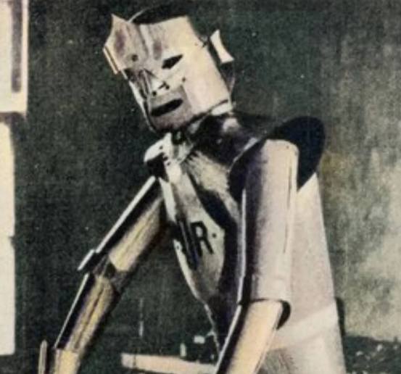
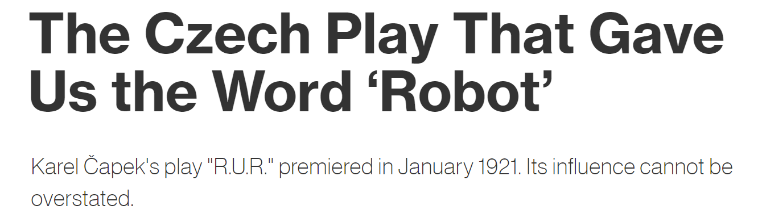
AI Update: “Automation” , “ChatGPT”, “Artificial Intelligence,” “Robot,” and “DeepSeek”
Normalized out of 100
May 2025
Source: Google Trends, Worldwide, 2004 to 2025. Play title MIT Press Reader: https://thereader.mitpress.mit.edu/origin-word-robot-rur/
Any data on past performance or results, modeling or back testing contained herein is no indication as to performance or results.
Notes:
8

Slide 9
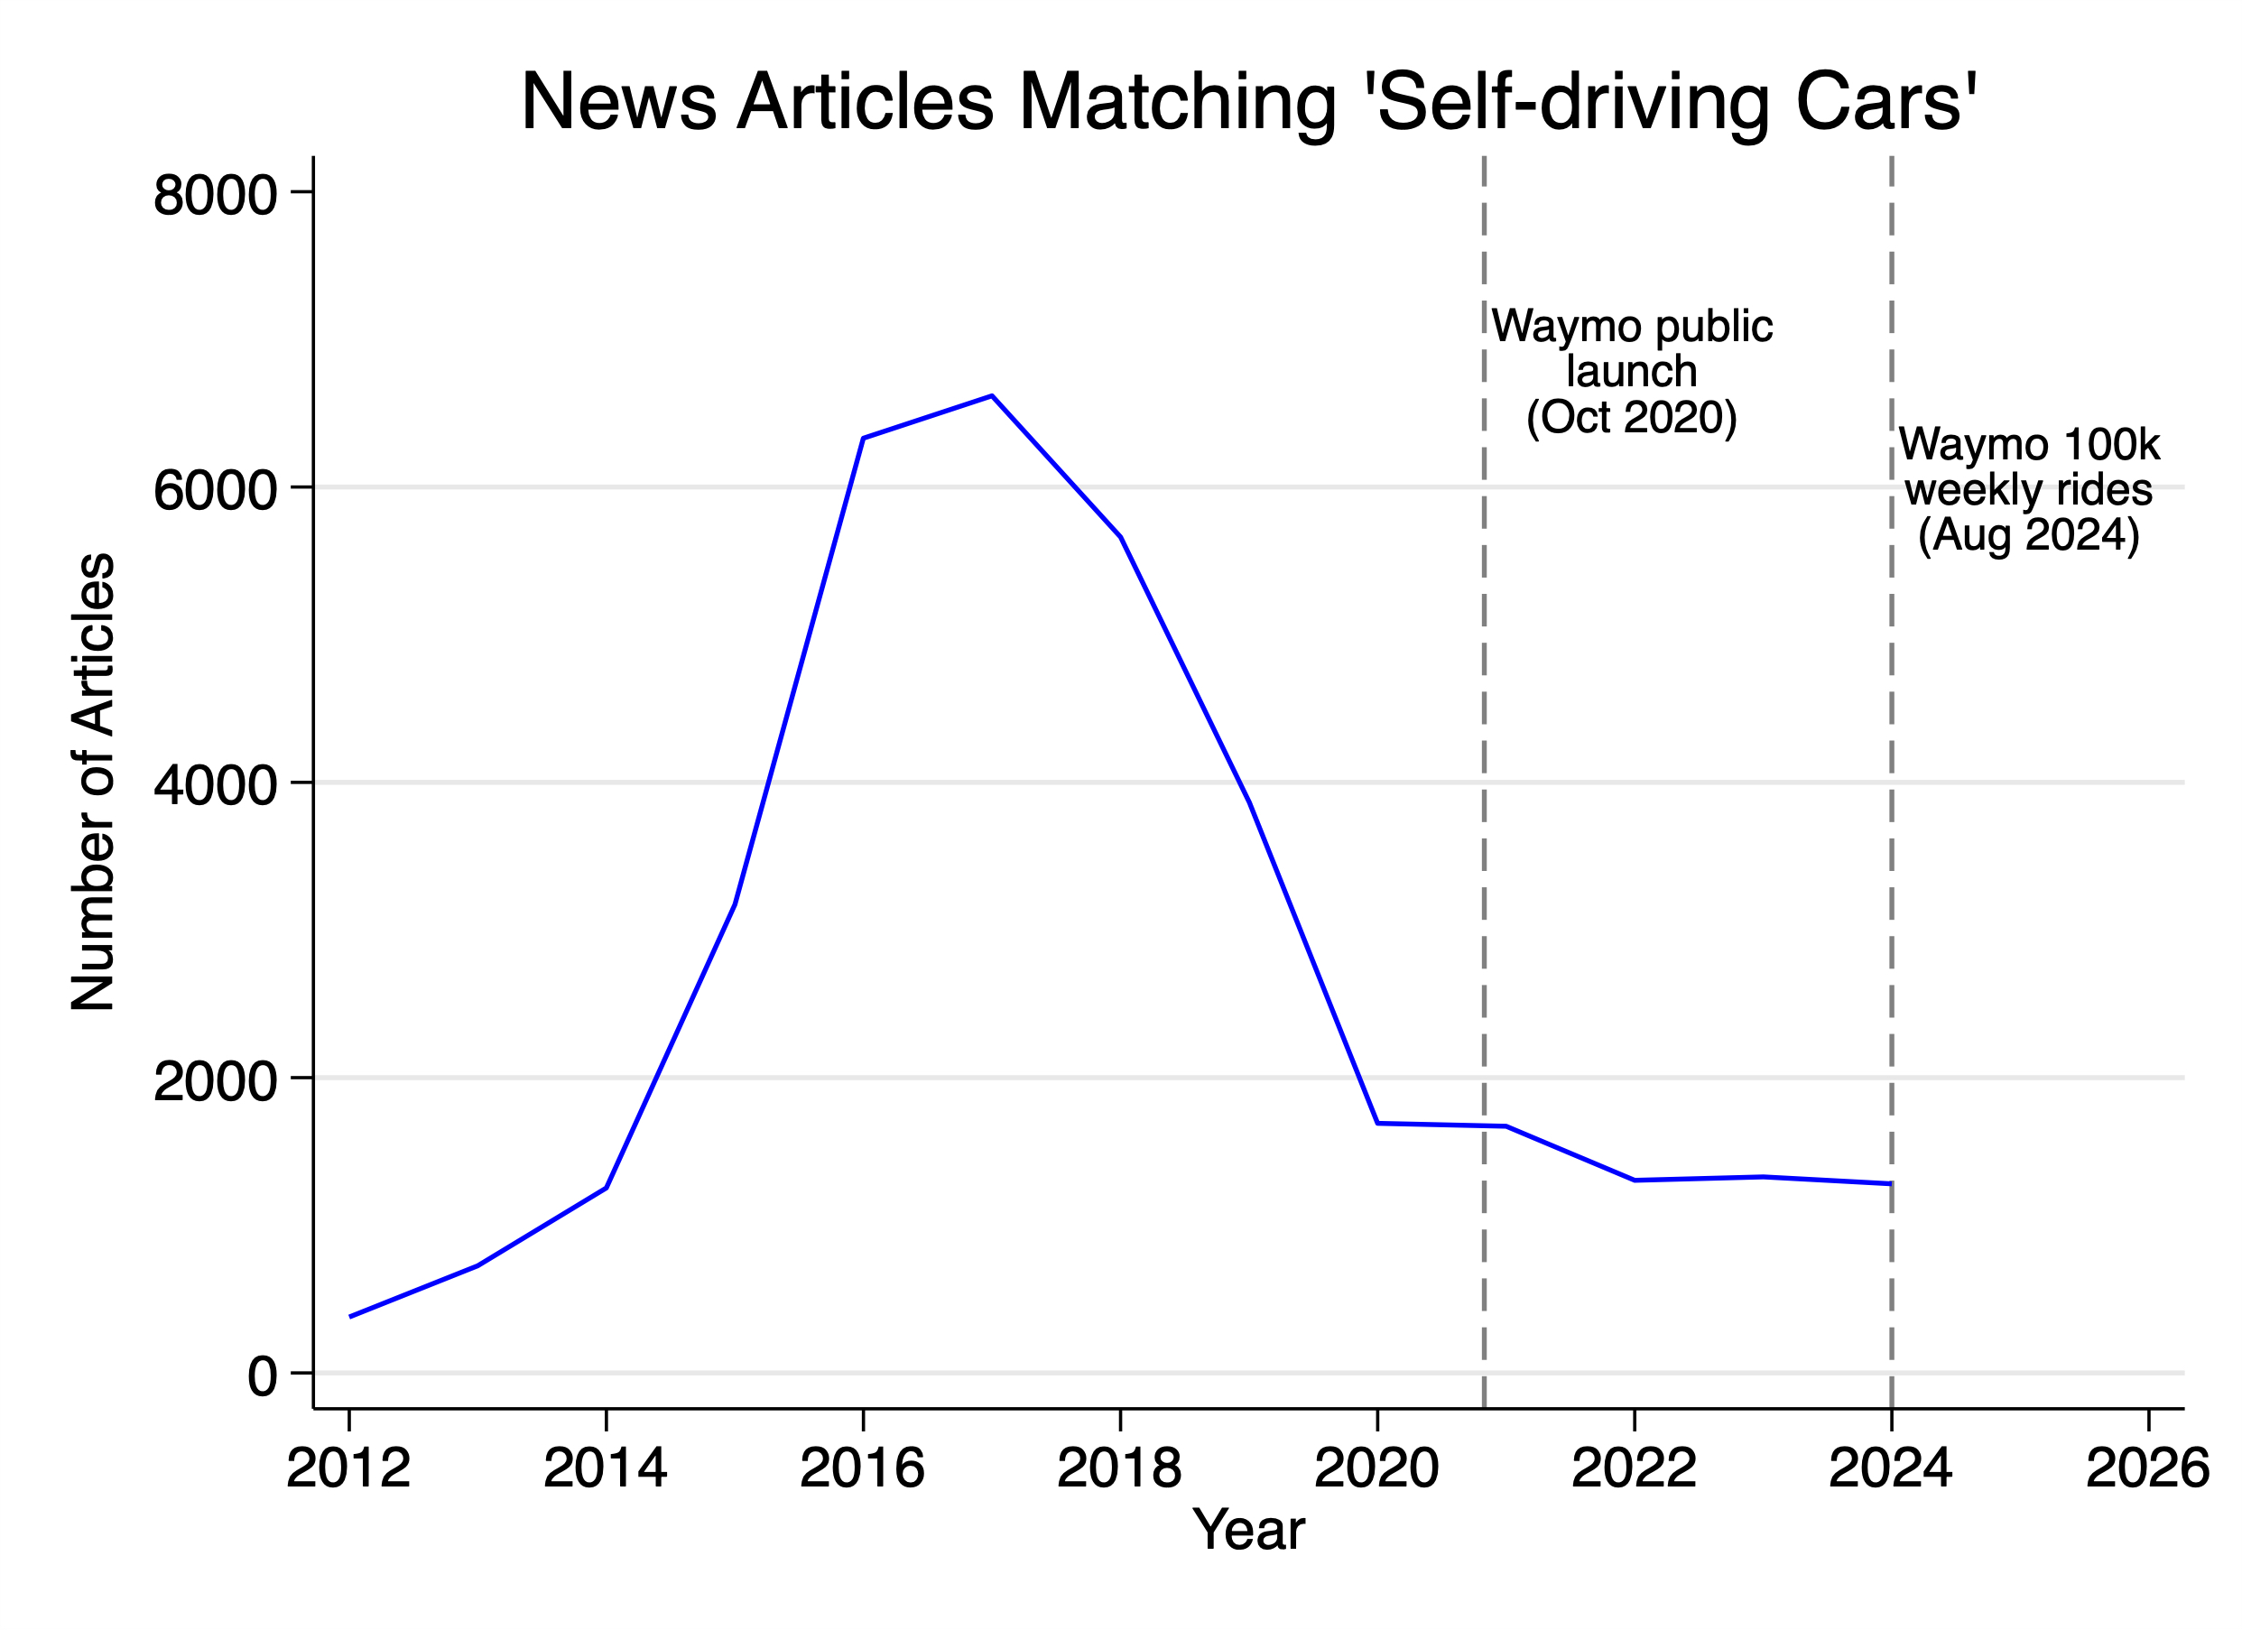
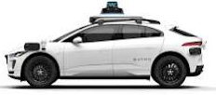
Development of New Technologies – Self Driving Cars?
Source: Proquest 2025. Any data on past performance or results, modeling or back testing contained herein is no indication as to performance or results.
Notes:
9

Slide 10
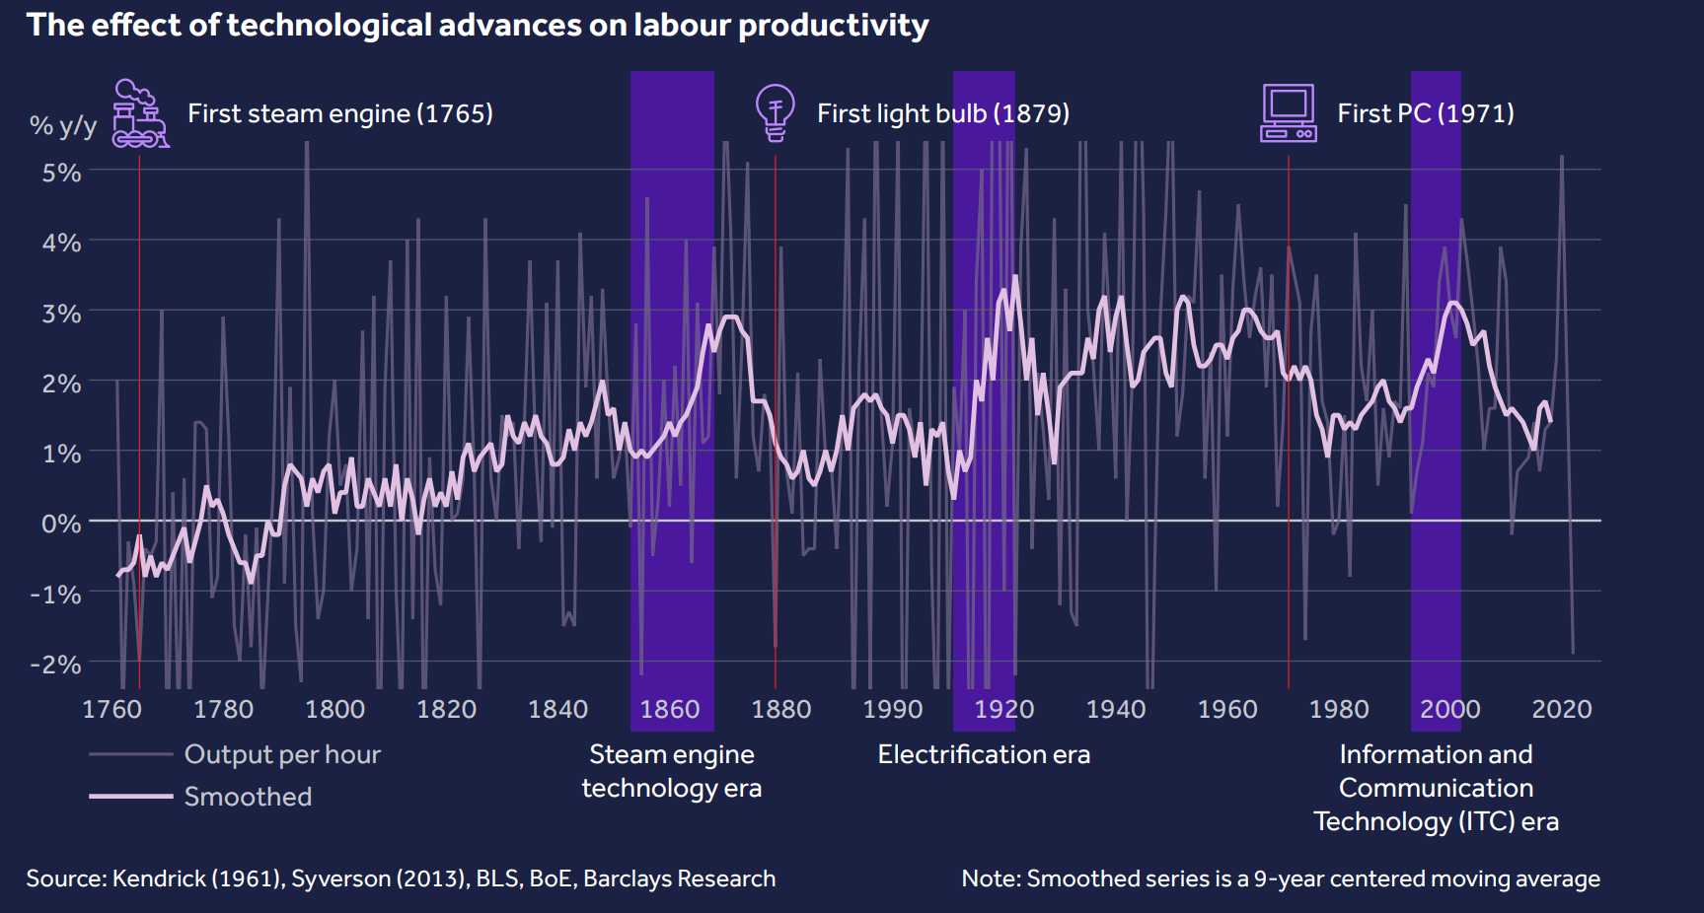
Development of New Technologies – When will AI be Impactful?
Source: AI revolution: productivity boom and beyond. Barclays/IBM, 2024 Any data on past performance or results, modeling or back testing contained herein is no indication as to performance or results.
Notes:
10

Slide 11
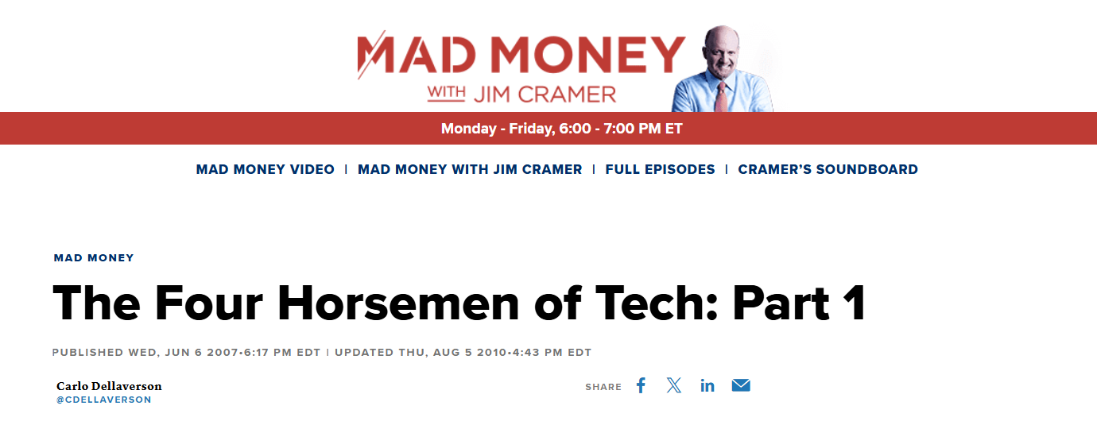

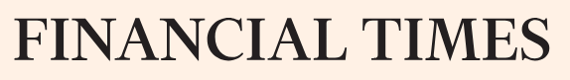
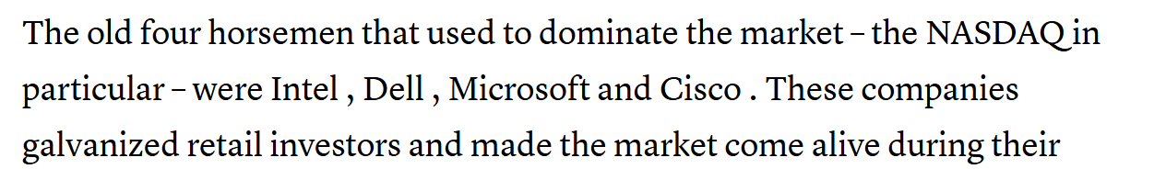
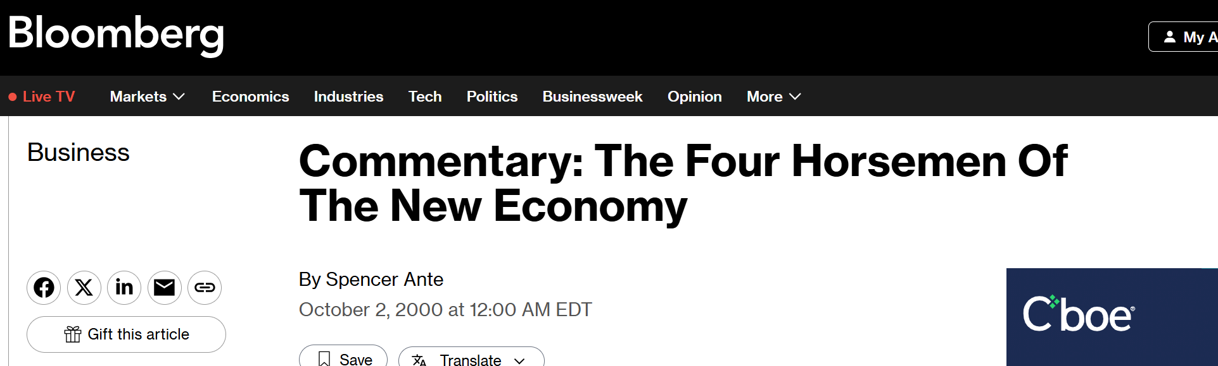
The Four Horseman. Do You Remember Them?
https://www.bloomberg.com/news/articles/2000-10-01/commentary-the-four-horsemen-of-the-new-economy?sref=OPW5PPeD. https://www.cnbc.com/2007/06/06/the-four-horsemen-of-tech-part-1.html.
Notes:
Stories: How do you know which index to allocate to? Manage expectations gap. CYA. You have the backing and power of TIS

Slide 12
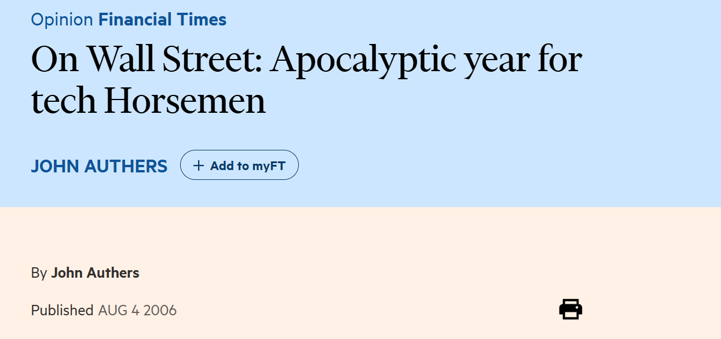
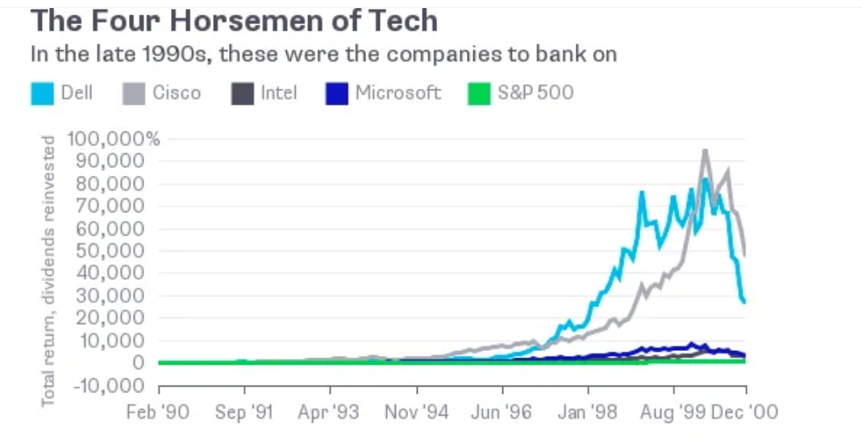
The Four Horseman vs Magnificent 7
FT: www.ft.com/content/4a10d3f6-23d5-11db-ae89-0000779e2340. . Any data on past performance or results, modeling or back testing contained herein is no indication as to performance or results.
Notes:
Stories: How do you know which index to allocate to? Manage expectations gap. CYA. You have the backing and power of TIS

Slide 13
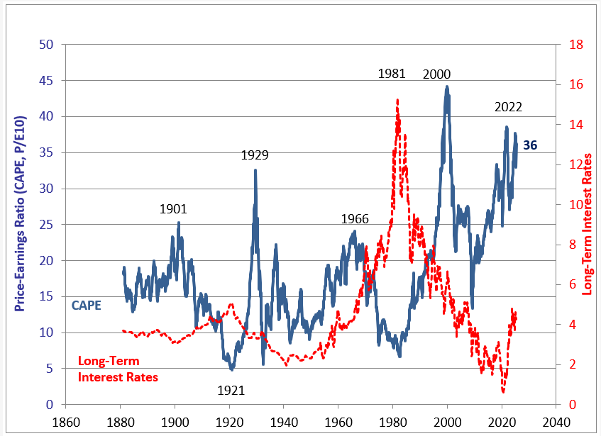
AI Narrative, Retail Investors & FOMO have Pushed Markets Back to High Levels
Source: Prof Robert J. Shiller. Shillerdata.com. Any data on past performance or results, modeling or back testing contained herein is no indication as to performance or results.
Notes:
13

Slide 14
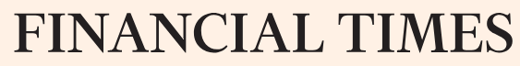
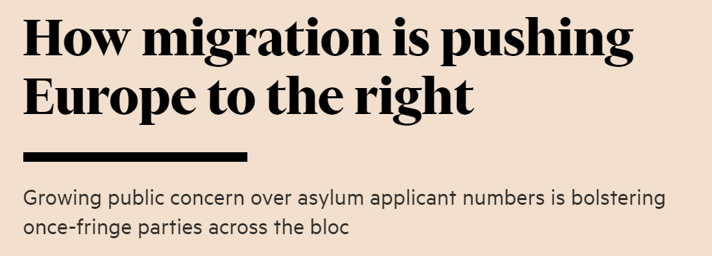
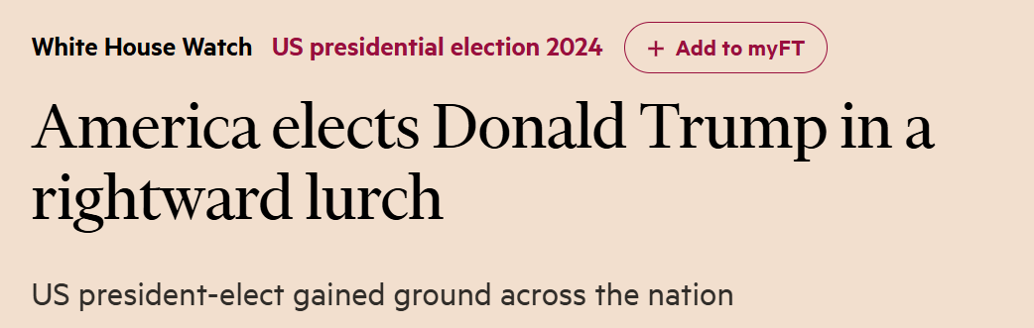
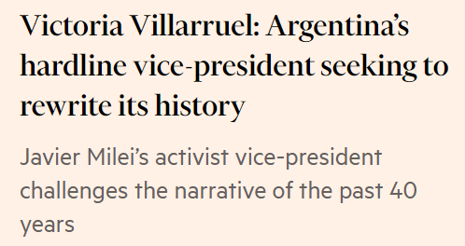
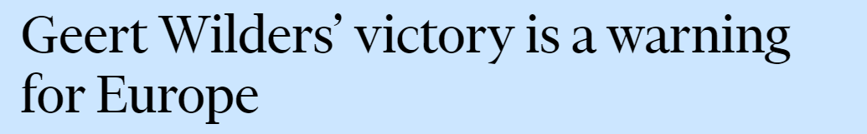

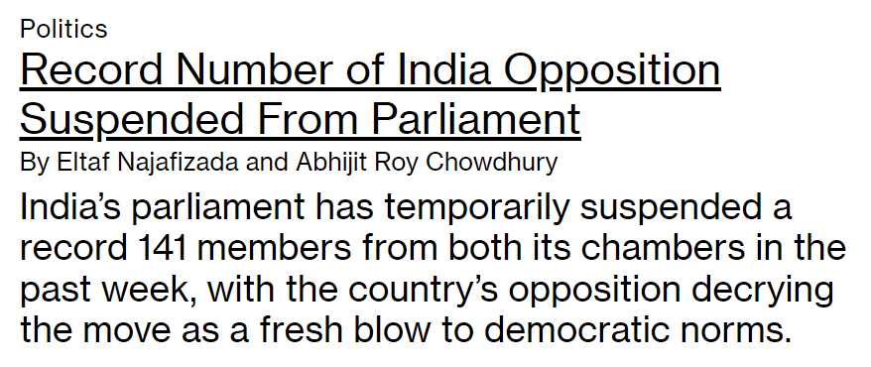

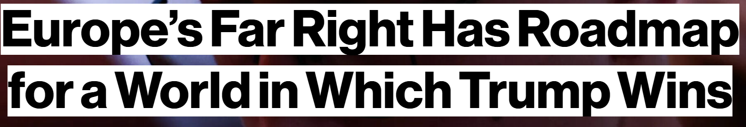
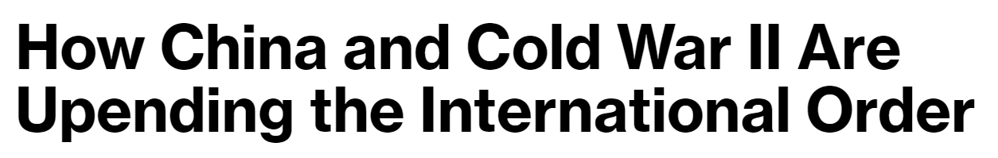
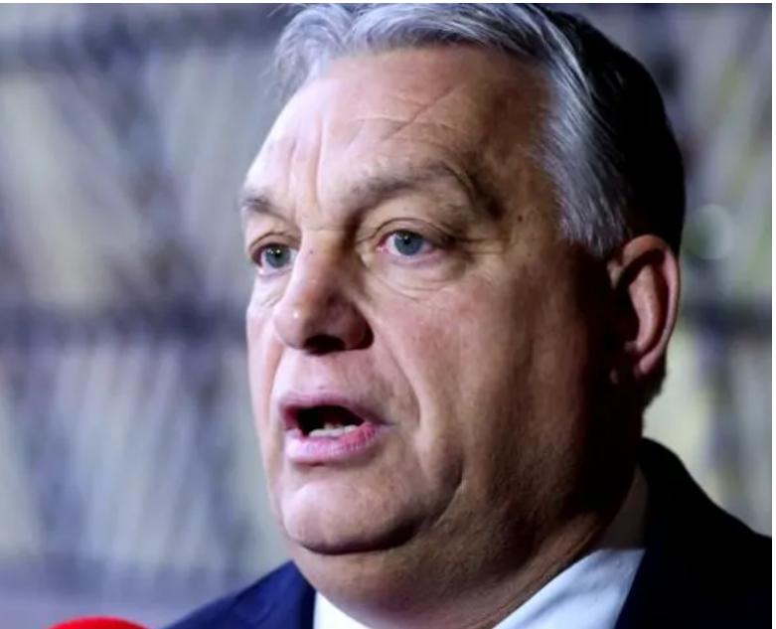

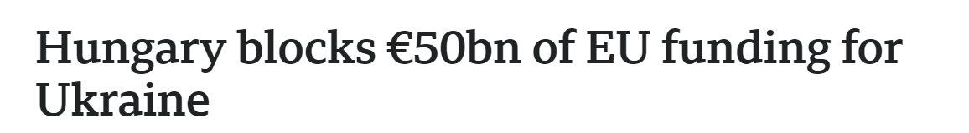
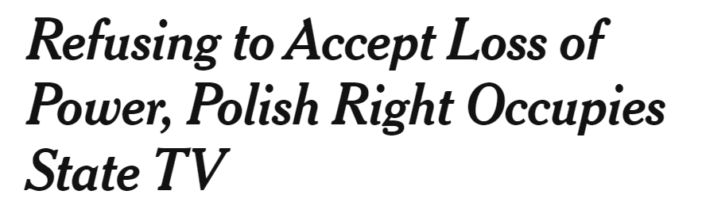
“Strongman” Narrative. Increases Uncertainty
Source: FT: https://www.ft.com/content/04dfd7c7-db53-4c64-881c-057b4300a83c; www.ft.com/content/79a34364-309f-4bd1-8f87-9d45e44cd0f7 &
NYT: www.nytimes.com/2023/12/20/world/europe/poland-state-tv-protest.html?searchResultPosition=3
Bloomberg: https://www.bloomberg.com/news/newsletters/2023-12-23/how-china-and-cold-war-ii-are-upending-the-international-order?sref=OPW5PPeD
https://www.bbc.com/news/world-europe-67724357, https://www.bloomberg.com/graphics/2024-trump-europe-populists/?sref=OPW5PPeD

Slide 15
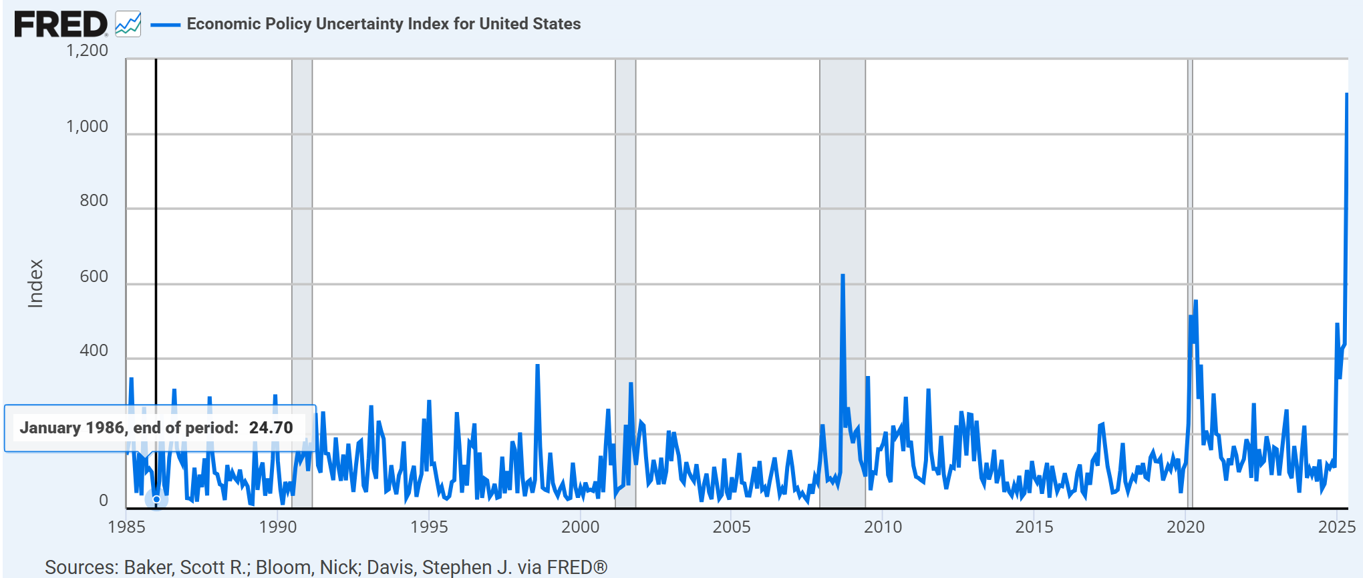
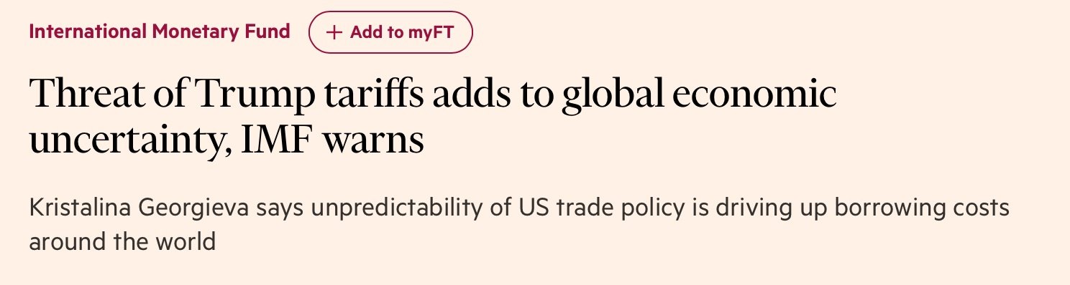
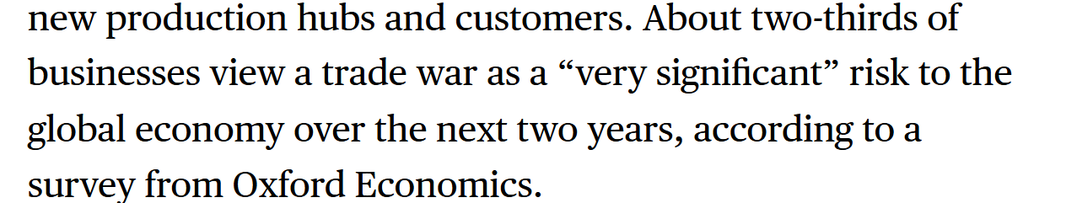
Uncertain World: Moving from Gradual Globalization to Disruptive Decoupling
Economic Policy Uncertainty Has Been Growing over the Years
Source: St Lous Fed/Economic Uncertainty Policy Unit Professors Baker, Bloom, Davis. FT and Bloomberg: Trade on Edge as Trump Tariffs Around Corner: Bloomberg Tracker, Dec 2024. Any data on past performance or results, modeling or back testing contained herein is no indication as to performance or results.
Notes:
15

Slide 16
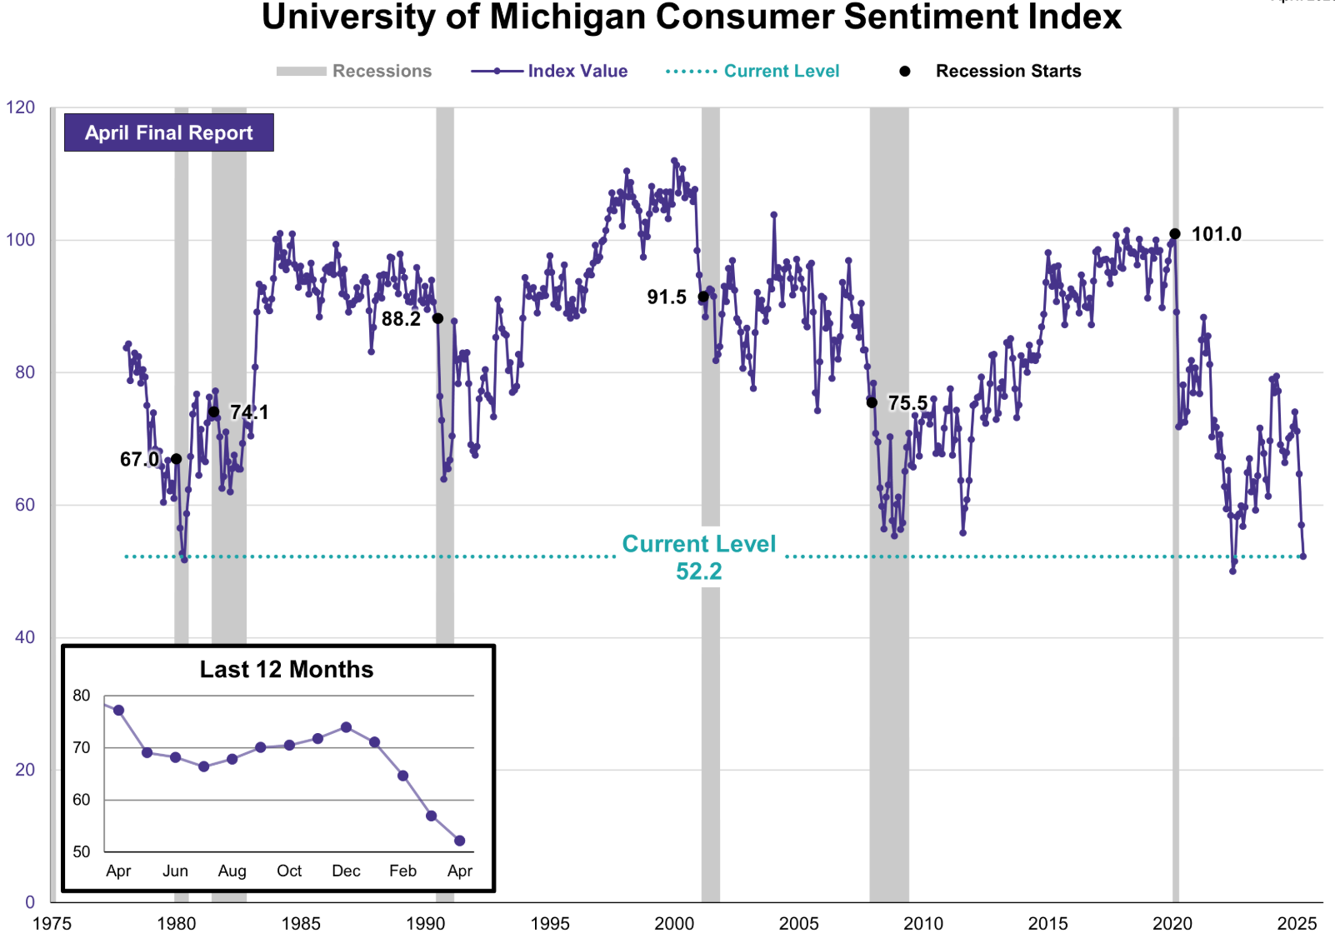
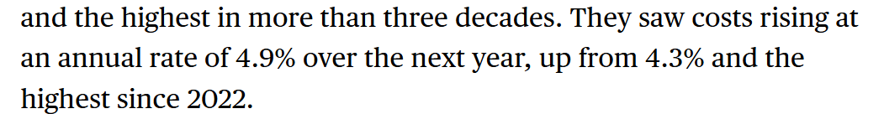

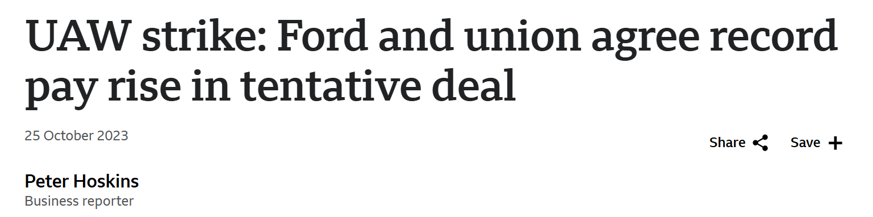
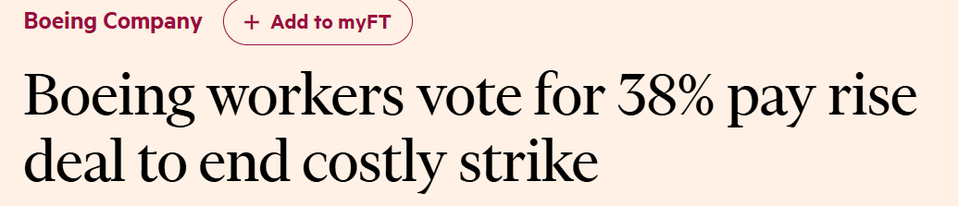
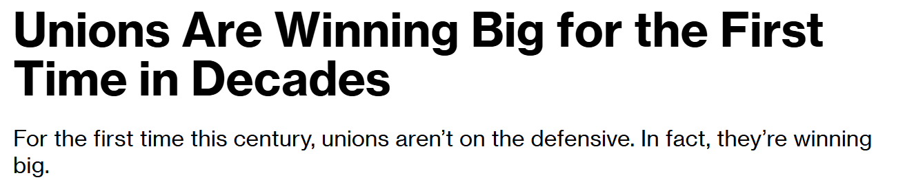
Uncertainty – Tariffs and Inflation
Consumers are Uncertain
Outlook – Oxford Economics
Higher and more volatile prices will be the norm as globalization comes to a halt.
Exchange rates, energy prices, import prices, and financing costs are all likely to fluctuate next year as the new US administration's agenda becomes clear.
Source: Michigan Consumer Survey Dec6th 2024. Initial Survey Results. Bloomberg: https://www.bloomberg.com/news/articles/2023-10-31/uaw-strike-ups-drivers-writers-union-mark-record-wins-for-us-labor-movement?sref=OPW5PPeD. BBC: https://www.bbc.com/news/business-67224476. Oxford Economics; Key Themes 2025: Global resilience gives way to uncertainty Any data on past performance or results, modeling or back testing contained herein is no indication as to performance or results.

Slide 17
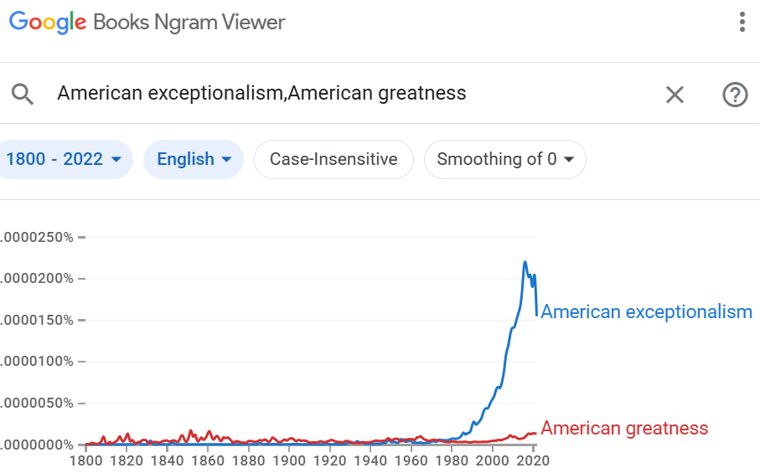
American Exceptionalism/Dynamism
Definition Today *: “American exceptionalism is the belief that the United States is either distinctive, unique, or exemplary compared to other nations.” Can also be applied to American Technology sector - > “Tech Exceptionalism”
Originally had a negative connotation, “great national myth of American exceptionalism is rooted in a widespread ignorance of history, and this ignorance breeds intolerance and hypocrisy”
Proquest Searches*
Ronald Regan may have originated the term with his slogan:
“Make America Great Again”
Source: Wikipedia, https://www.proquest.com/news/docview/282461492/210EA0C248EC4E94PQ/1?accountid=15172

Slide 18

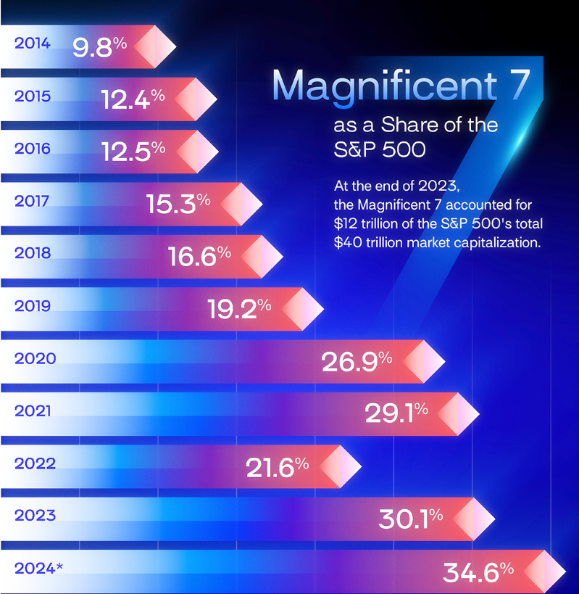
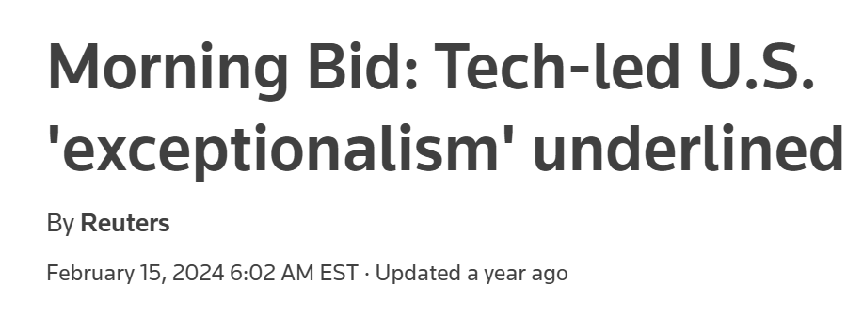

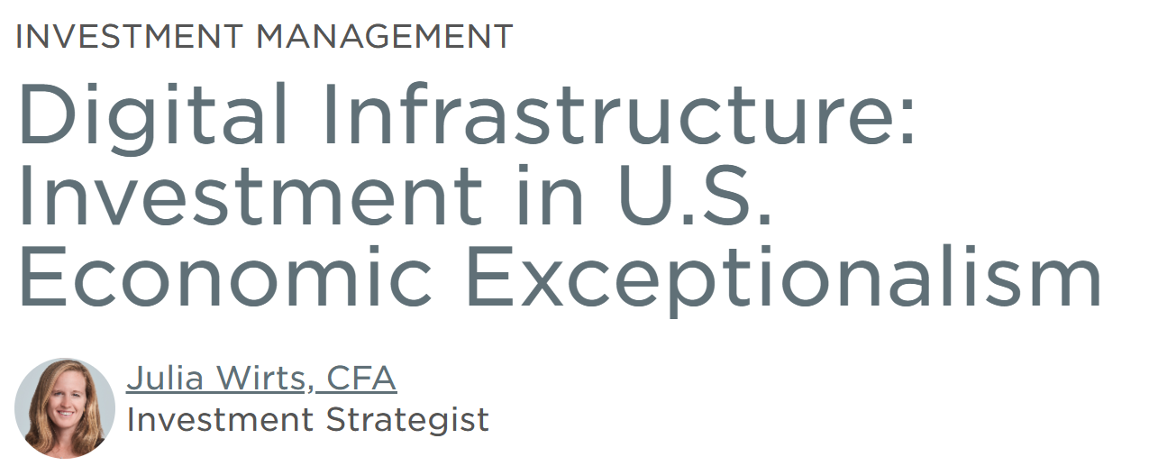
American Exceptionalism/Dynamism
Belief in US Technology. But…
How much further can this run?
Source: Reuters, Wilmington Trust & www.visualcapitalist.com/sp/charted-magnificent-7-market-cap-as-a-share-of-the-sp-500/. Any data on past performance or results, herein is no indication as to performance or results.

Slide 19
Disclaimer
This presentation represents the opinion of Robert J. Shiller, RSBB I, LLC and its consultant, IndexVestLAB, LLC and consultants thereto. It is not intended to be a forecast of future events, a guarantee of future results or investment advice with respect to any securities or other investment products.
The presentation should not be deemed an offer or sale of any securities or other investment products and should not be relied on for such purpose. This presentation should not be distributed to any person other than the intended recipient. The user of this information assumes the entire risk of any use made of the information provided herein.
Professor Shiller is Sterling Professor of Economics Emeritus at Yale University and Fellow at the International Center for Finance, Yale School of Management. None of Professor Shiller, Yale University or any other party involved in making or compiling any of the information included in this presentation, makes any express or implied warranty or representation with respect to its content, form or any use thereof.

